Slide 1




Slide 2

VOCABULARY (HOMOPHONES,HOMONYMS,
HETERONYMS)

Slide 3
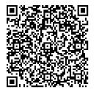
Test time on : Analogies
QR CODE:

Slide 4
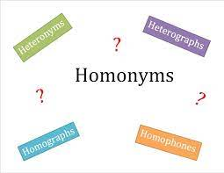
Question: 01
CONCEPTS
What are homonyms, heterographs and heteronyms?
What’s in the name?

Slide 5
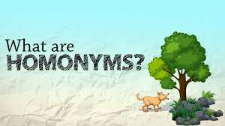
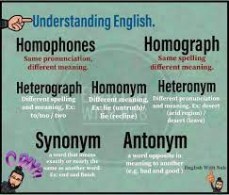
Question: 01
CONCEPTS
What are homophones and heterographs?

Slide 6
Question: 01
CONCEPTS
What are homophones and heteronyms?

Slide 7
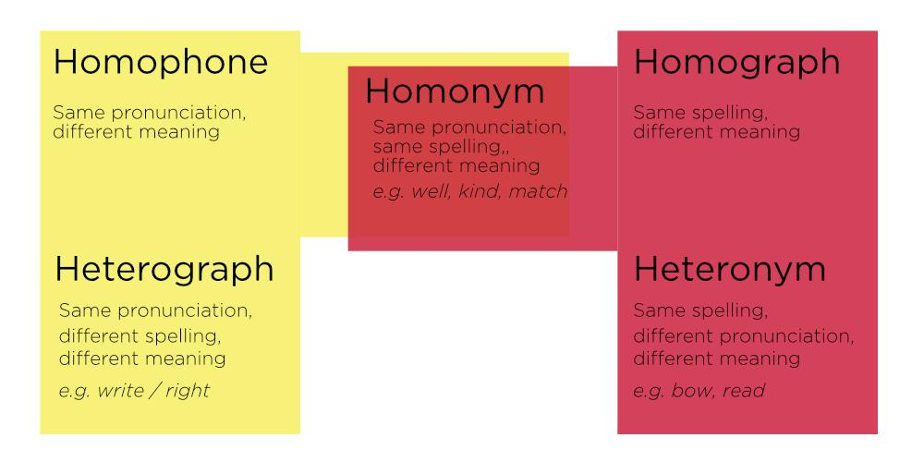
Question: 01
CONCEPTS
What does this mean for you?

Slide 8
Question: 01
CONCEPTS
Homonyms, Homophones, and Homographs
Here is a listing of some the most common homonyms, homophones, and homographs. The first column contains homonyms in alphabetical order, while the second and third columns list the corresponding homonym, homophone, or homograph as applicable.
accept - take in | except - other than
ad - advertisement | add - join, combine
advice - guidance | advise - recommend
aid - assist, assistance | aide - one who gives assistance
ail - to suffer poor health | ale - a beverage

Slide 9
Question: 01
CONCEPTS
air - atmosphere | ere - before | heir - one who inherits property
aisle - a passage | I'll - contraction of I will | isle - island
allusion - an indirect reference | illusion - false appearance
altar - table in a church | alter - to change
ate - past tense of eat | eight - the number 8

Slide 10
Question: 01
CONCEPTS
bail - to clear water | bail - release of a prisoner | bale - a large bundle
band - a ring, something that binds | band - a group | banned - prohibited
bare - uncovered | bear - large animal | bear - support, yield
bases - starting points | bases - four stations on a baseball field | basis - a basic principle
beat - to strike, overcome | beat - exhausted | beet - a plant with red roots

Slide 11
Question: 01
CONCEPTS
blew - past tense of blow | blue - the color
bread - baked food item | bred - produced
buy - purchase | by - near, through | bye - goodbye
capital - punishable by death | capital - chief city | capitol - building where legislature meets
ceiling - top of a room | sealing - setting, fastening

Slide 12
Question: 01
CONCEPTS
cell - compartment | sell - vend
cent - penny coin | scent - an odor | sent - past tense of send
cereal - breakfast food | serial - sequential
chews - gnaws with teeth | choose - to select
Chile- country in South America | chili - bean stew | chilly - frosty
chord - musical tone | cord - rope
cite - quote | site - location | sight - view

Slide 13
Question: 01
CONCEPTS
close - opposite of open | clothes - clothing
coarse - rough | course - path, procedure
complement – enhance; go together | compliment - praise
conduct - behavior | conduct - to lead
council - committee | counsel - guidance

Slide 14
Question: 01
CONCEPTS
creak - squeak | creek - stream of water
crews - gangs | cruise - ride on a boat
days - plural of day | daze - stun
dear - darling | deer- woodland animal
desert - to abandon | desert - dry land | dessert - after-dinner treat
dew - morning mist | do - operate | due - payable
die - cease to exist | dye - color

Slide 15
Question: 01
CONCEPTS
discreet - tactful | discrete - distinct
doe - female deer | dough - uncooked bread
dual - double | duel - battle
elicit - draw out | illicit - illegal
eminent - distinguished | imminent - soon
ewe - female sheep | you - second-person personal pronoun
eye - sight organ | I - first-person personal pronoun

Slide 16
Question: 01
CONCEPTS
facts - true things | fax - a document transmitted via telephone
fair - equal | fare - price
fairy - elf like creature with wings | ferry - boat
faze - impact | phase - stage
feat - achievement | feet - plural of foot
find - to discover | fined - charged a penalty
fir - type of tree | fur - animal hair
flea - small biting insect | flee - run

Slide 17
Question: 01
CONCEPTS
flew - did fly | flu - illness
flour - powdery, ground up grain | flower - blooming plant
for - on behalf of | fore - front | four - three plus one
forth - onward | fourth - number four
foreword - introduction to a book | forward - advancing
gene - a chromosome | jean - fabric; pants
gorilla - big ape | guerrilla - warrior

Slide 18
Question: 01
CONCEPTS
grease - fat | Greece - country in Europe
groan - moan | grown - form of grow
hair - head covering | hare - rabbit-like animal
hall - passageway | haul - tow
halve - cut in two parts | have - possess
hay - animal food | hey - interjection to get attention
heal - mend | heel - back of foot
hear - to listen | here - at this place

Slide 19
Question: 01
CONCEPTS
hi - hello | high - up far
hoarse - croaky | horse - riding animal
hole - opening | whole - entire
holey - full of holes | holy - divine | wholly - entirely
hoarse - rough voice | horse - animal
hour - sixty minutes | our - belonging to us
knead - massage | need - desire
knew - did know | new - not old

Slide 20
Question: 01
CONCEPTS
knight - feudal horseman | night - evening
knot - tied rope | not - negative
know - have knowledge | no - opposite of yes
lead - metal | led - was the leader
leased - past tense of lease | least - the minimum
lessen - make smaller | lesson - class
loan - lend | lone - solitary

Slide 21
CONCEPTS
made - did make | maid - servant
mail - postage | male - opposite of female
material - matter | materiel - supplies for an organization, particularly the military
marry - to wed | merry - very happy
meat - animal protein | meet - encounter
mince - to chop finely | mints - type of sweet
morning - a.m. | mourning - remember the dead

Slide 22
Question: 01
CONCEPTS
none - not any | nun - woman who takes special vows
oar - boat paddle | or - otherwise | ore - mineral
oh - expression of surprise or awe | owe - be obligated
one - single | won - did win
overdo - do too much | overdue - past due date
pail - bucket | pale - not bright
pain - hurt | pane - window glass
peace - calm | piece - segment

Slide 23
Question: 01
CONCEPTS
peak – highest point | peek - glance
patience - being willing to wait | patients - person treated in a hospital or by a doctor
pear - a type of fruit | pair - two (usually matching)
plain - ordinary | plane - flight machine plane; flat surface
pole - post | poll - survey
poor - not rich | pour - make flow

Slide 24
Question: 01
CONCEPTS
pray - implore God | prey - quarry
principal - most important | principle - belief
rain – water from sky | rein - bridle
rap - tap | wrap - drape around
read - past tense of the verb to read | red - color
real - factual | reel - roll
right - correct; not left | write - scribble
ring - encircle | wring - squeeze

Slide 25
CONCEPTS
road - street | rode - past tense of ride
role - function | roll - rotate
rose - flower | rows - lines
sail - move by wind power | sale - bargain price
scene - landscape | seen - viewed
sea - ocean segment | see - observe with eyes
seam - joining edge | seem - appear
sew - connect with thread | so - as a result | sow - plant

Slide 26
Question: 01
CONCEPTS
soar - ascend | sore - hurt place
sole - single | soul - essence
son - male child | sun - the star that lights the solar system
some - a few | sum - amount
stair - step | stare - to look at steadily
steal - swipe | steel - alloy
suite - large room in a hotel | sweet - the opposite of sour

Slide 27
Question: 01
CONCEPTS
threw - past tense of throw | through - passing from one place to another
to - toward | too - also | two - the number2
toe - foot appendage | tow - pull along
vary - differ | very - wail - howl
wail - howl | whale - huge sea mammal
waist - area below ribs | waste - squander

Slide 28
Question: 01
CONCEPTS
wait – kill time | weight - measurable load
war - battle | wore - did wear
warn - caution | worn - used
way - path | weigh - measure mass
we - us | wee - tiny
weak - not strong | week - seven days
wear - to don attire | where - question word

Slide 29
Question: 01
CONCEPTS
weather - climate | whether - if
which - that | witch - sorcerer
wood - material coming from trees | would - conditional auxiliary
your - belonging to you | you’re - you are

Slide 30
Question: 01
QUESTION
1.“He simply sat down on the ledge and forgot everything _____ [accept or except] the marvelous mystery.”— Lawrence Sargent Hall

Slide 31
Question: 01
ANSWER
1. except

Slide 32
Question: 01
QUESTION
2."I live in the Oakland Hills in a tiny house on a street so windy you can’t drive more than ten miles per hour. I rented it because the _____ [ad or add] said this: 'Small house in the trees with a garden and a fireplace. Dogs welcome, of course.'"— Pam Houston

Slide 33
Question: 01
ANSWER
2. ad

Slide 34
Question: 01
QUESTION
3."Francis wondered what _____ [advice or advise] a psychiatrist would have for him."— John Cheever

Slide 35
Question: 01
ANSWER
3. advice

Slide 36
Question: 01
QUESTION
4."The _____ [aid or aide] gets out of the way, picking her skirt out of the rubble of children at her feet."— Rosellen Brown

Slide 37
Question: 01
ANSWER
4. aide

Slide 38
Question: 01
QUESTION
5."He seemed to want to recapture the cosseted feeling he'd had when he'd been sick as a child and she would serve him flat ginger _____ [ail or ale], and toast soaked in cream, and play endless card games with him, using his blanket-covered legs as a table."— Alice Elliott Dark

Slide 39
Question: 01
ANSWER
5. ale

Slide 40
Question: 01
QUESTION
6."He sat down and leaned forward, pulling the chair's rear legs into the _____ [air, ere, or heir] so that the waitress could get by."— Stanley Elkins

Slide 41
Question: 01
ANSWER
6. air

Slide 42
Question: 01
QUESTION
7."[T]he stewardess was moving down the _____ [aisle, I'll, or isle], like a trained nurse taking temperatures in a hospital ward, to see that they were all properly strapped in for the take-off."— Martha Gellhorn

Slide 43
Question: 01
ANSWER
7. aisle

Slide 44
Question: 01
QUESTION
8."Mrs. Parmenter laughed at his _____ [allusion or illusion] to their summer at Mrs. Sterrett's, in Rome, and gave him her coat to hold."— Willa Cather

Slide 45
Question: 01
ANSWER
8. allusion

Slide 46
Question: 01
QUESTION
9."In the long years between, she had fashioned many fine dresses—gowned gay girls for their conquests and robed fair brides for the _____ [altar or alter]."— Mary Lerner

Slide 47
Question: 01
ANSWER
9. altar

Slide 48
Question: 01
QUESTION
10."On a Saturday morning soon after he came to live with her, he turned over her garbage while she was at the grocery store and _____ [ate or eight] rancid bacon drippings out of a small Crisco can."— Pam Durban

Slide 49
Question: 01
ANSWER
10. ate

Slide 50
Question: 01
QUESTION
11."The barn was bigger than a church, and the fall's fresh hay _____ [bails or bales] were stacked to the roof in the side mows."— John Updike

Slide 51
Question: 01
ANSWER
11. bales

Slide 52
Question: 01
QUESTION
12."Her two spare dresses were gone, her comb was gone, her checkered coat was gone, and so was the mauve hair-_____ [band or banned] with a mauve bow that had been her hat."— Vladimir Nabokov

Slide 53
Question: 01
ANSWER
12. band

Slide 54
Question: 01
QUESTION
13."Without the shelter of those trees, there is a great exposure—back yards, clotheslines, woodpiles, patchy sheds and barns and privies—all _____ [bare or bear], exposed, provisional looking."— Alice Munro

Slide 55
Question: 01
ANSWER
13. bare

Slide 56
Question: 01
QUESTION
14."This was the time when outfields were larger than they are today and well-hit balls would roll for a long time, giving runners ample time to round the _____ [bases or basis] for a home run."— Deidre Silva and Jackie Koney

Slide 57
Question: 01
ANSWER
14. bases

Slide 58
Question: 01
QUESTION
15."The conductor had his knotted signal cord to pull, and the motorman _____ [beat or beet] the foot gong with his mad heel."— Saul Bellow

Slide 59
Question: 01
ANSWER
15. beat

Slide 60
Question: 01
QUESTION
16."Nancy held the cup to her mouth and _____ [blew or blue] into the cup."— William Faulkner

Slide 61
Question: 01
ANSWER
16. blew

Slide 62
Question: 01
QUESTION
17."A pigeon landed nearby. It hopped on its little red feet and pecked into something that might have been a dirty piece of stale _____ [bread or bred] or dried mud."— Isaac Bashevis Singer

Slide 63
Question: 01
ANSWER
17. bread

Slide 64
Question: 01
QUESTION
18."He was wearing a new hat of a pretty biscuit shade, for it never occurred to him to _____ [buy, by, or bye] anything of a practical color; he had put it on for the first time and the rain was spoiling it."— Katherine Anne Porter

Slide 65
Question: 01
ANSWER
18. buy

Slide 66

https://learn.codemithra.com

Slide 67




THANK YOU
+91 78150 95095
codemithra@ethnus.com
www.codemithra.com

